Slide 1

GITAM SCHOOL OF TECHNOLOGY Department Of CSE Project On "Emotion based Music recommendation system"
Project Guide:- Beena G Pillai
Assistant Professor
Of CSE
DATE:- 29-03-2023
DAY:- Wednesday
Group Members:- (Batch G3)
Karivemula Sivani (321910307002)
Surya Prakash S (321910307017)
Ediga Renuka (321910307018)
Jayanth Kumar G (321910307038)
Suhas Gowda M (321910307057)

Slide 2
Introduction:-
Emotion based music player is a music player based on machine learning techniques which suggests the songs of the playlist based on a person's emotions and input.
People in the current world are suffering from a lot of stress related diseases due to various reasons.
One of the stress relief activities is listening to music, If the music played does not suit the current emotion of the listener, it may aggravate stress of the user further.
This project proposes an emotion-based music player, which suggests songs based on user’s various emotions namely happy, sad, angry and neutral.
Emotion-based music recommendation can be beneficial in many ways. It helps the users to discover new music that they might not have found otherwise, and it can be also provided by a personalized listening experience that matches their current mood.
Algorithm used in this project is ANN (Artificial Neural Networks), fisherface and Media Pipe/Package.

Slide 3
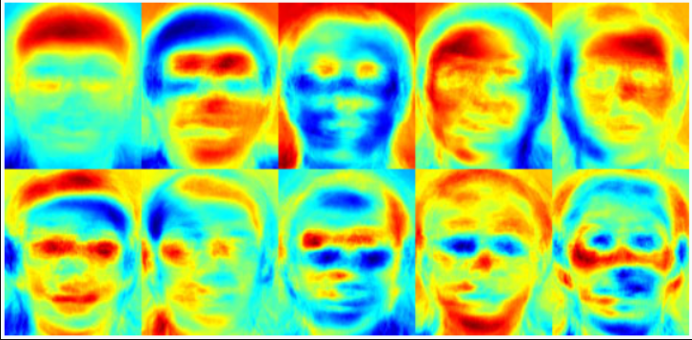
ABSTRACT:-
The Project is to develop an Emotion Based Music Recommendation System,Which is an Web Based Application meant for users to Listen songs based on their facial emotion.
The proposed model will extract user’s facial expressions and features to determine the current mood of the user.
The aim of emotion-based music recommendation is to enhance the user's listening experience by providing them with music that resonates with their current emotions.
Once the emotion is detected , playlist of songs suitable to the mood of the user will be presented to the user.

Slide 4
Existing System
In the present system the music player, plays the music based the user input.
Present system is not AI integrated
In the current system you have to listen trending or random or you wanted song or you have to follow you music playlist.
Current system there are different systems like MoodFuse helps analyze the emotional content of song,
Last.fm Users can search for songs based on their mood and receive recommendations based on their listening history.
It takes more time to classify large number of songs.
This music streaming service has a "mood" feature that allows users to select a mood (e.g. happy, sad, energetic) and then generates a playlist based on that mood.

Slide 5

Problem Statement
The primary problem with existing music recommendation systems is their inability to capture the emotional context of Music.
The problem statement for an emotion-based music recommendation system is to design and implement an algorithm that can detect the emotional context of a music track and recommend music that is emotionally with the listener's current mood in efficient manner.
The system must consider various factors such as musical characteristics, lyrics, and the listener's music preferences and history to generate accurate recommendations.
The solution to this problem will require advanced algorithms that can accurately classify Face recongnition into different emotional categories and use machine learning to learn from user feedback to improve recommendation accuracy over time.
As a result, music lovers often struggle to find music that aligns with their mood or current emotional state.

Slide 6
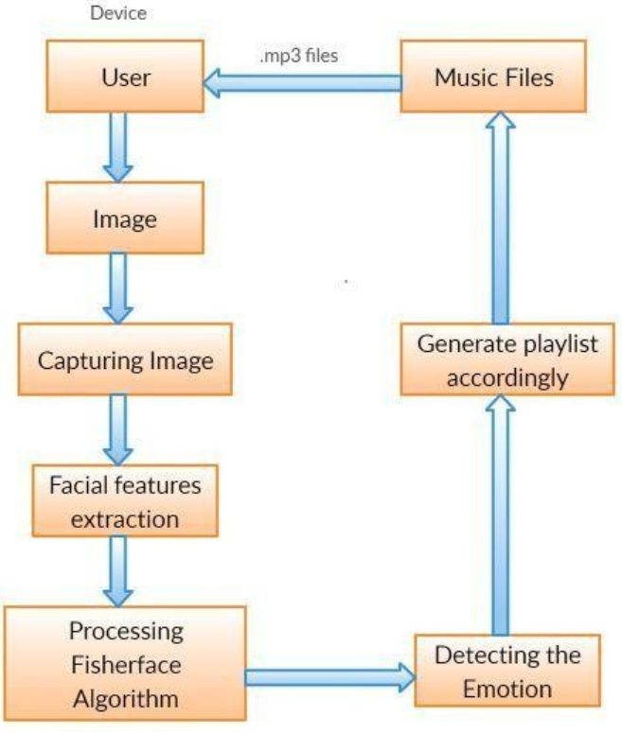
System Architecture:-

Slide 7
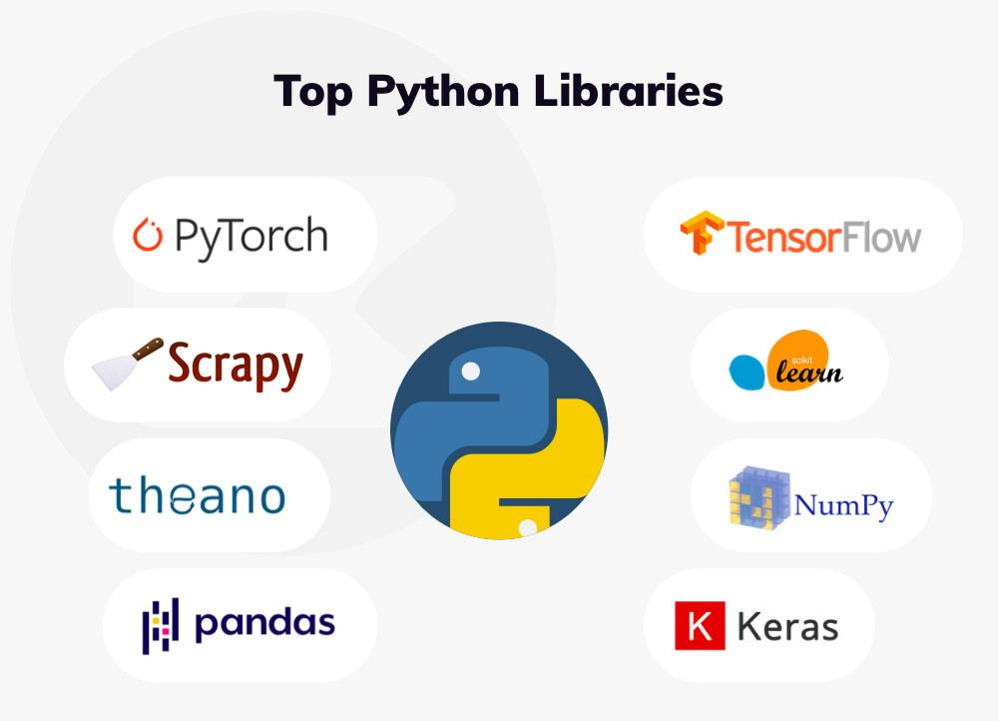
Necessary Libraries:
TensorFlow
Streamlit
Keras
Numpy
Streamlit-webrtc

Slide 8
Streamlit:- is a free and open-source framework to rapidly build and share beautiful machine learning and data science web apps. Streamlit is a Python-based library that allows data scientists to easily create free machine learning applications.
Streamlit allows you to display descriptive text and model outputs, visualize data and model performance and modify model inputs through the UI using sidebars.
Keras:- is used to make the implementation of neural networks easy. It also supports multiple backend neural network computation.
Keras is a deep learning API written in Python, running on top of the machine learning platform TensorFlow. It was developed with a focus on enabling fast experimentation.
TensorFlow:- is a free and open-source software library for machine learning and artificial intelligence. It can be used across a range of tasks but has a particular focus on training and inference of deep neural networks.
It also supports traditional machine learning. TensorFlow was originally developed for large numerical computations without keeping deep learning in mind.

Slide 9
Streamlit-webrtc:-
Streamlit-webrtc is a Python library that enables real-time video and audio streaming in web applications built with Streamlit.
It is built on top of WebRTC, a technology for real-time communication between web browsers, and allows for easy integration of video and audio streams in Streamlit applications.
Numpy:- Numpy is a library for the Python programming language, adding support for large, multi-dimensional arrays and matrices, along with a large collection of high-level mathematical functions to operate on these arrays.
Moreover Numpy forms the foundation of the Machine Learning stack.

Slide 10
Literature survey
Author, Journal Name, Title, Year | Methodologies | Limitations
Title: Emotion-Based Music Player Author: Krittrin Chankuptarat, Raphatsak Sriwatanaworachai Year:2021 | EMO algorithm | Manual selection of songs. Randomly played/shuffled songs may not match the mood of the user. Emotions based music players now in use are less accurate, time consuming and do not cover all emotions. playlist
Title:Real Time Emotion Based Music Player Using CNN Architectures Author: Sulaiman Muhammad, Safeer Ahmed Year:2021 | Global average pooling (GAP) model Conventional Neural network | Accuracy is Low

Slide 11
Title: AFFECTIVE MUSIC PLAYER FOR MULTIPLE EMOTION RECOGNITION USING FACIAL EXPRESSIONS WITH SVM Year:2021 | SVM classifier based on Kaggle dataset | securing the control of users' emotions.
Title: A Machine Learning Based Music Player by Detecting Emotions Year:2019 | SVM classifier and PyCharm tool for analysis. | less in feature are detected using SVM classifier
Title :Spotify Genre Recommendation Based on User Emotion Using Deep Learning Year:2022 | Haar cascade,MTCNN | Works only on Threshold values

Slide 12
Hardware Requirements
PC with core i3 processor
4GB RAM or above
50GB hard disk or above
2GB graphic card or above
• Windows 11,10 ,7,8/Linux
• Python 3.7
• Python Packages
Software Requirements

Slide 13

Data Collection
Data collection is the process of gathering and measuring information from countless different sources.
In order to build intelligent applications capable of understanding, machine learning models need to digest large amounts of structured training data.
Data collection allows you to capture a record of past events so that we can use data analysis to find recurring patterns.
From those patterns, you build predictive models using machine learning algorithms that look for trends and predict future changes.
The data needs to be error-free and contain relevant information for the task at hand.

Slide 14
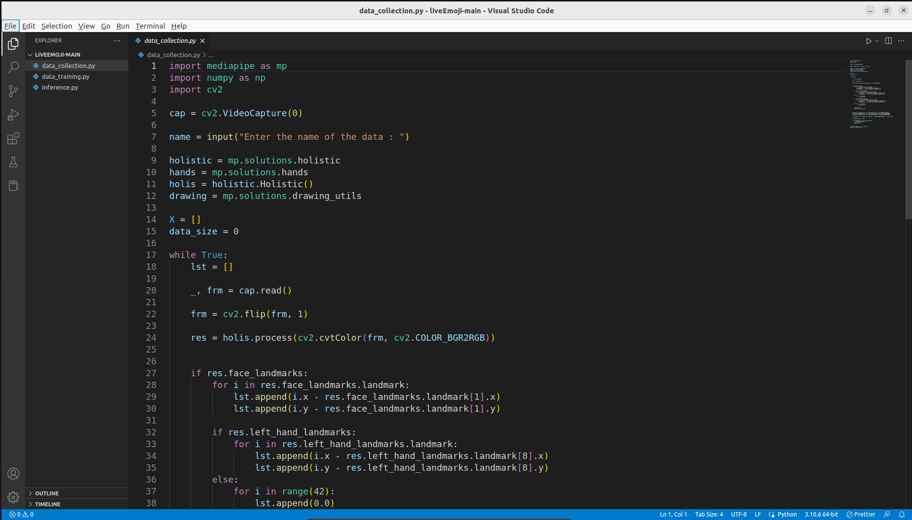
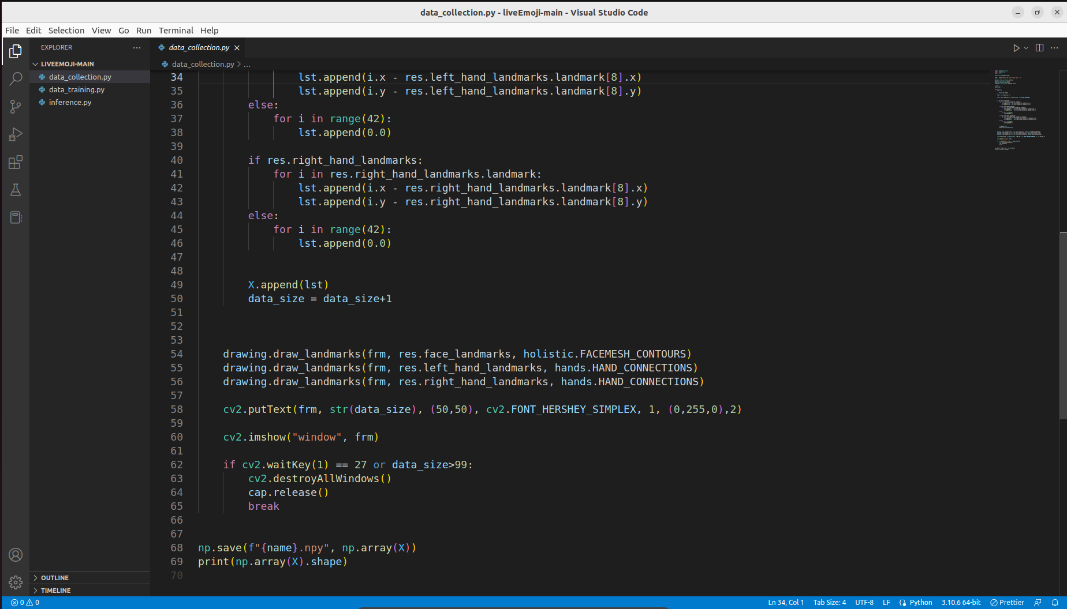

Slide 15
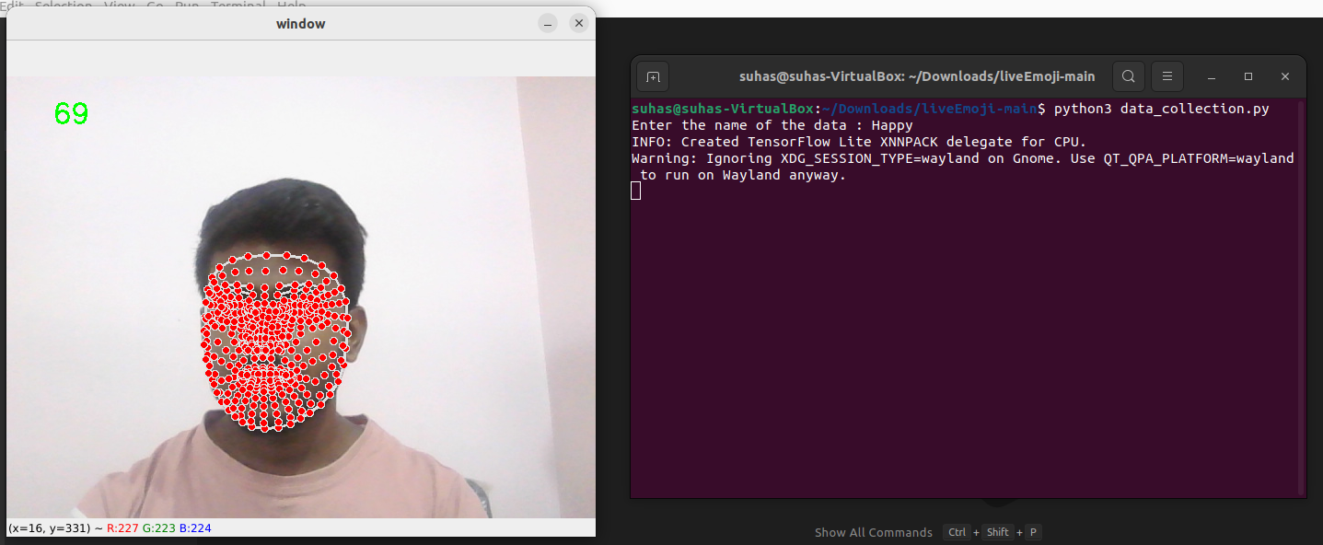

Slide 16
Data Training
The training data is the biggest subset of the original dataset, which is used to train or fit the machine learning model. Firstly, the training data is fed to the ML algorithms, which lets them learn how to make predictions for the given task.
Once the model is trained enough with the relevant training data, it is tested with the test data. We can understand the whole process of training and testing in three steps, which are as follows:-
1.Feed: Firstly, we need to train the model by feeding it with training input data.
2.Define: Now, training data is tagged with the corresponding outputs (in Supervised Learning), and the model transforms the training data into text vectors or a number of data features.
3.Test: In the last step, we test the model by feeding it with the test data/unseen dataset. This step ensures that the model is trained efficiently and can generalize well.

Slide 17
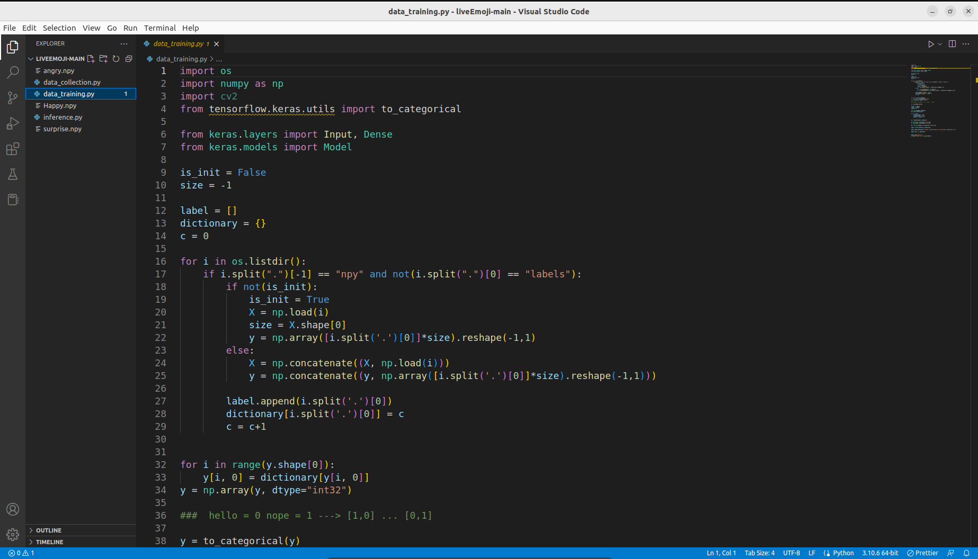
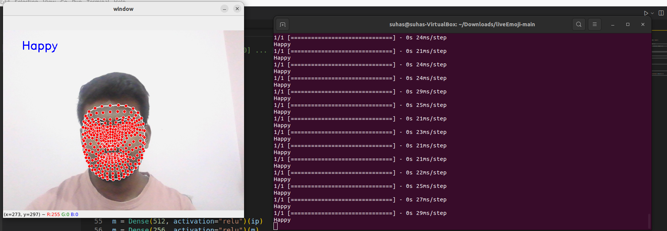

Slide 18
Conclusion
Emotion-based music recommendation is a powerful tool that can help individuals discover new music that resonates with their current emotional state. By analyzing the emotional content of songs and comparing it to the listener's current emotional state, recommendation systems can provide personalized music suggestions that are more likely to resonate with the listener.
However, emotion-based music recommendation systems are not without their limitations. First, accurately measuring the emotional content of music can be challenging, as emotions can be complex and subjective. Additionally, individuals may not always be aware of their own emotional state or may have difficulty expressing it accurately. Finally, while emotion-based music recommendation systems can help individuals discover new music, they may also reinforce existing emotional states and preferences, potentially limiting exposure to new musical genres and styles.

Slide 19
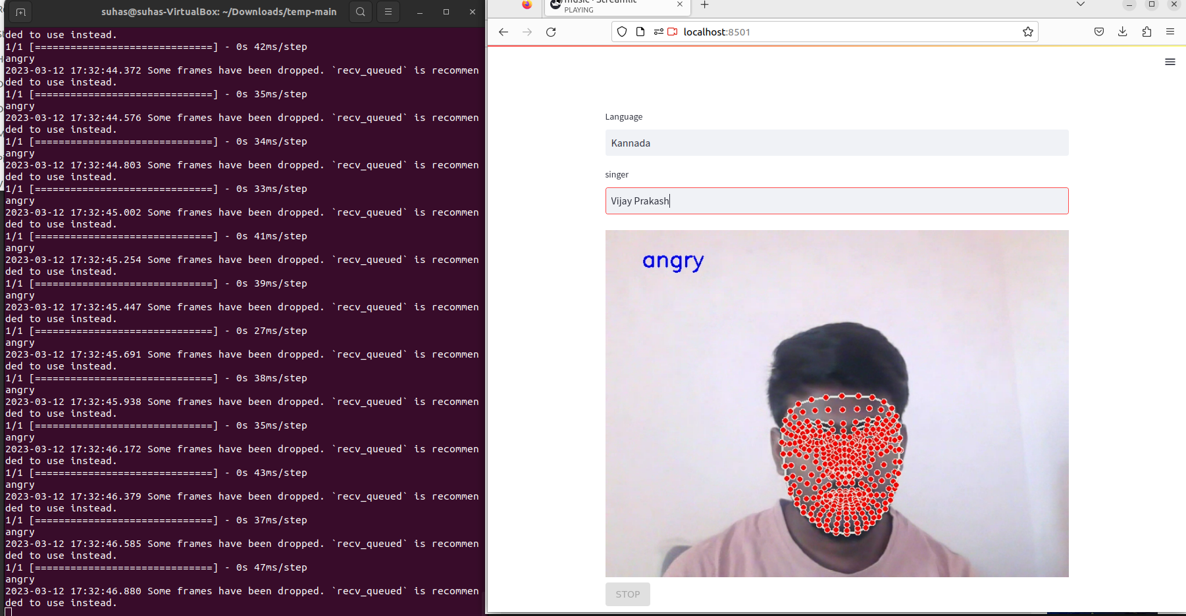
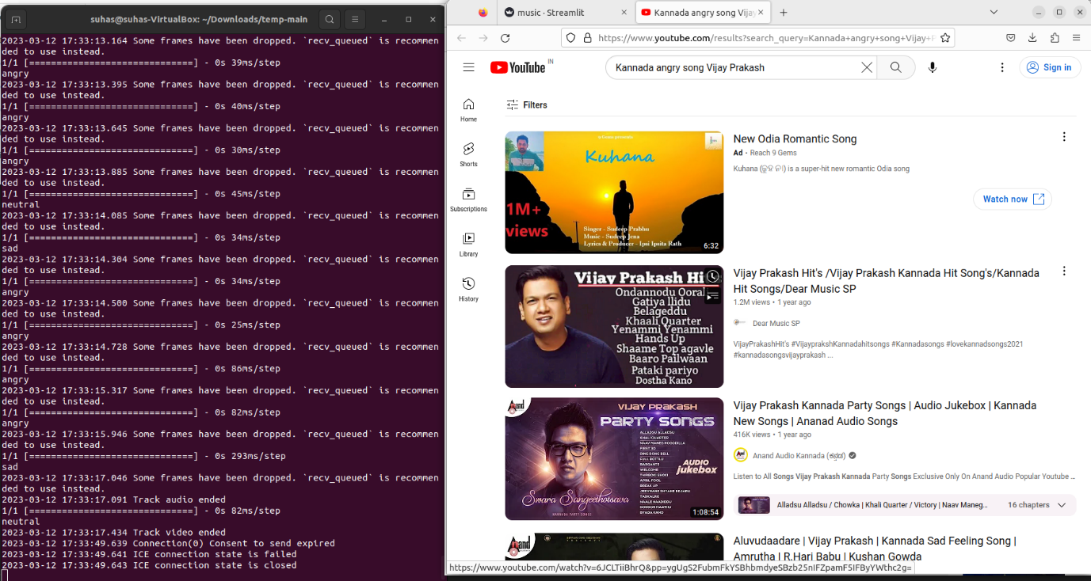
Output

Slide 20
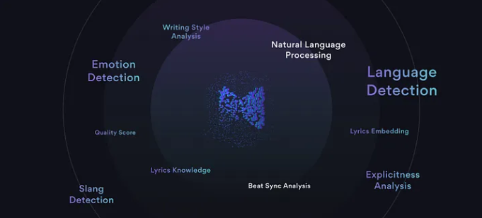
Future Scope:-
Emotion detection: The system needs to be able to detect the user's emotional state
based on their input, such as their facial expressions, or even their browsing history.
The system able to adapt to the user’s emotional
states over the time and adjust its recommendations
accordingly.
For better productivity the system needs to
be integrated into a music streaming service
or app so that it can access the user’s
listening history and provide real-time recommendations.
Overall, the scope of emotion-based music recommendation systems involves combining advanced technologies such as artificial intelligence, machine learning, and natural language processing to provide a personalized and emotionally resonant music experience for users.

Slide 21
Reference
[1] Agarwal, G., and Om, H. (2021). An efficient supervised framework for music mood recognition using autoencoder-based optimised support vector regression model. IET Signal Process.
[2] A Novel Music Emotion Recognition Model Using Neural Network Technology(2021) Sec. Emotion Science
[3] Aljanaki, A., Yang, Y. H., and Soleymani, M. (2017). Developing a benchmark for emotional analysis of music.
[4] Bressan, G. M., and Azevedo, B. C. F. (2018). A comparison of classifiers for musical genres classification and music emotion recognition. Adv. Math. Sci. Appl.

Slide 22
THANK YOU

